Slide 2

Photo: Argonne National Laboratory
Notes:
In the last lecture we talked about neutral theory and we did simulations – we found that it takes a lot of CPU power to do them …..

Slide 3
High Performance Computing (HPC)
Introduction to HPC and why it’s useful
How do you parallelize your code?
The practice of running software on a cluster
Notes:
Talk about graphics cards and problems that are not embarrassingly parallel, talk about Moore’s law and the revlopution of computing
ATTENTION – it’s not the solution to all your problems.

Slide 4

Introduction to HPC and why it’s useful
Notes:
Talk about graphics cards and problems that are not embarrassingly parallel, talk about Moore’s law and the revlopution of computing

Slide 5

Introduction to HPC and why it’s useful
Notes:
Talk about graphics cards and problems that are not embarrassingly parallel, talk about Moore’s law and the revlopution of computing

Slide 6
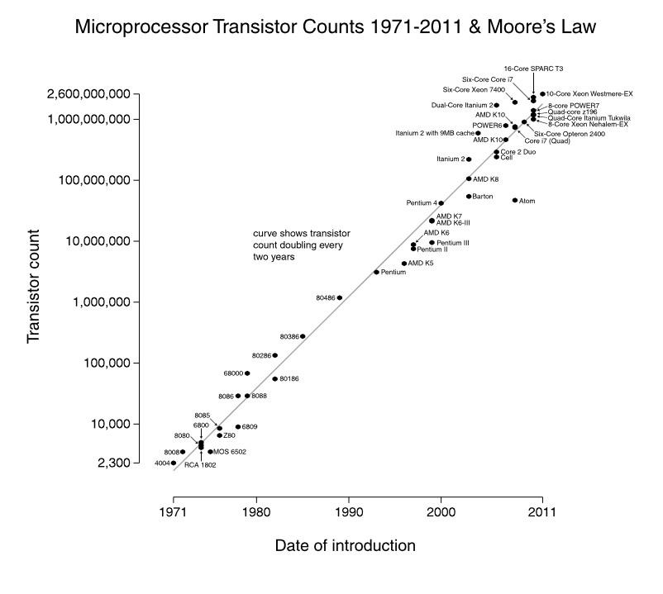
Introduction to HPC and why it’s useful
Notes:
Talk about graphics cards and problems that are not embarrassingly parallel, talk about Moore’s law and the revlopution of computing

Slide 7
Introduction to HPC and why it’s useful
Jan 2015 update: $6.7 billion
Notes:
Talk about graphics cards and problems that are not embarrassingly parallel, talk about Moore’s law and the revlopution of computing

Slide 8
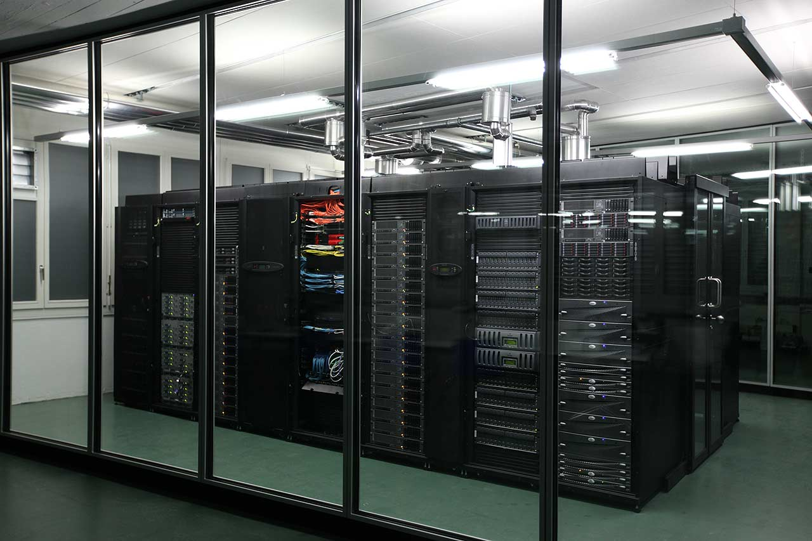
Introduction to HPC and why it’s useful
Embarrassingly parallel problems
Graphics
Simulations with multiple parameters
Notes:
Talk about graphics cards and problems that are not embarrassingly parallel, talk about Moore’s law and the revlopution of computing

Slide 9
Introduction to HPC and why it’s useful
Embarrassingly parallel problems
Graphics
Simulations with multiple parameters
Non embarrassingly parallel problems
Fluid dynamics
A lot of the tasks run by a single program
Notes:
Talk about graphics cards and problems that are not embarrassingly parallel, talk about Moore’s law and the revlopution of computing

Slide 10
How do you parallelize your code?
as.numeric(Sys.getenv("PBS_ARRAY_INDEX"))
Should be used in your code to give a simulation number
Before
Simulation
Notes:
Talk about graphics cards and problems that are not embarrassingly parallel, talk about Moore’s law and the revlopution of computing

Slide 11
How do you parallelize your code?
as.numeric(Sys.getenv("PBS_ARRAY_INDEX"))
Should be used in your code to give a simulation number
Before
Now
Simulation
Simulation 1
Simulation 2
Simulation 3
Notes:
Talk about graphics cards and problems that are not embarrassingly parallel, talk about Moore’s law and the revlopution of computing

Slide 12
How do you parallelize your code?
as.numeric(Sys.getenv("PBS_ARRAY_INDEX"))
Should be used in your code to give a simulation number
Before
Now
Simulation
Simulation 1
Simulation 2
Simulation 3
Notes:
Talk about graphics cards and problems that are not embarrassingly parallel, talk about Moore’s law and the revlopution of computing

Slide 13
Using your PC
for ( i in 1 : 10 )
{
do_simulation( i )
}

Slide 14
Using your PC
for ( i in 1 : 10 )
{
do_simulation( i )
}
Shell script on the cluster
Using HPC
i <- as.numeric(Sys.getenv("PBS_ARRAY_INDEX"))
do_simulation( i )
i <- as.numeric(Sys.getenv("PBS_ARRAY_INDEX"))
do_simulation( i )
i <- as.numeric(Sys.getenv("PBS_ARRAY_INDEX"))
do_simulation( i )
i <- as.numeric(Sys.getenv("PBS_ARRAY_INDEX"))
do_simulation( i )
i <- as.numeric(Sys.getenv("PBS_ARRAY_INDEX"))
do_simulation( i )
i <- as.numeric(Sys.getenv("PBS_ARRAY_INDEX"))
do_simulation( i )
i <- as.numeric(Sys.getenv("PBS_ARRAY_INDEX"))
do_simulation( i )
i <- as.numeric(Sys.getenv("PBS_ARRAY_INDEX"))
do_simulation( i )
i <- as.numeric(Sys.getenv("PBS_ARRAY_INDEX"))
do_simulation( i )
i <- as.numeric(Sys.getenv("PBS_ARRAY_INDEX"))
do_simulation( i )

Slide 15
How do you parallelize your code?
as.numeric(Sys.getenv("PBS_ARRAY_INDEX"))
Should be used in your code to give a simulation number
Before
Now
Simulation
Any seed
Simulation 1
Any seed ?
Simulation 2
Any seed ?
Simulation 3
Any seed ?
Notes:
Talk about graphics cards and problems that are not embarrassingly parallel, talk about Moore’s law and the revlopution of computing

Slide 16
How do you parallelize your code?
as.numeric(Sys.getenv("PBS_ARRAY_INDEX"))
Should be used in your code to give a simulation number
Pseudo random numbers
Given a certain random number seed, you get the same sequence of random numbers every time
Each simulation should have a different seed
Simulation 1
Seed
= 1
Simulation 2
Seed
= 2
Simulation 3
Seed
= 3
Notes:
Talk about graphics cards and problems that are not embarrassingly parallel, talk about Moore’s law and the revlopution of computing

Slide 17
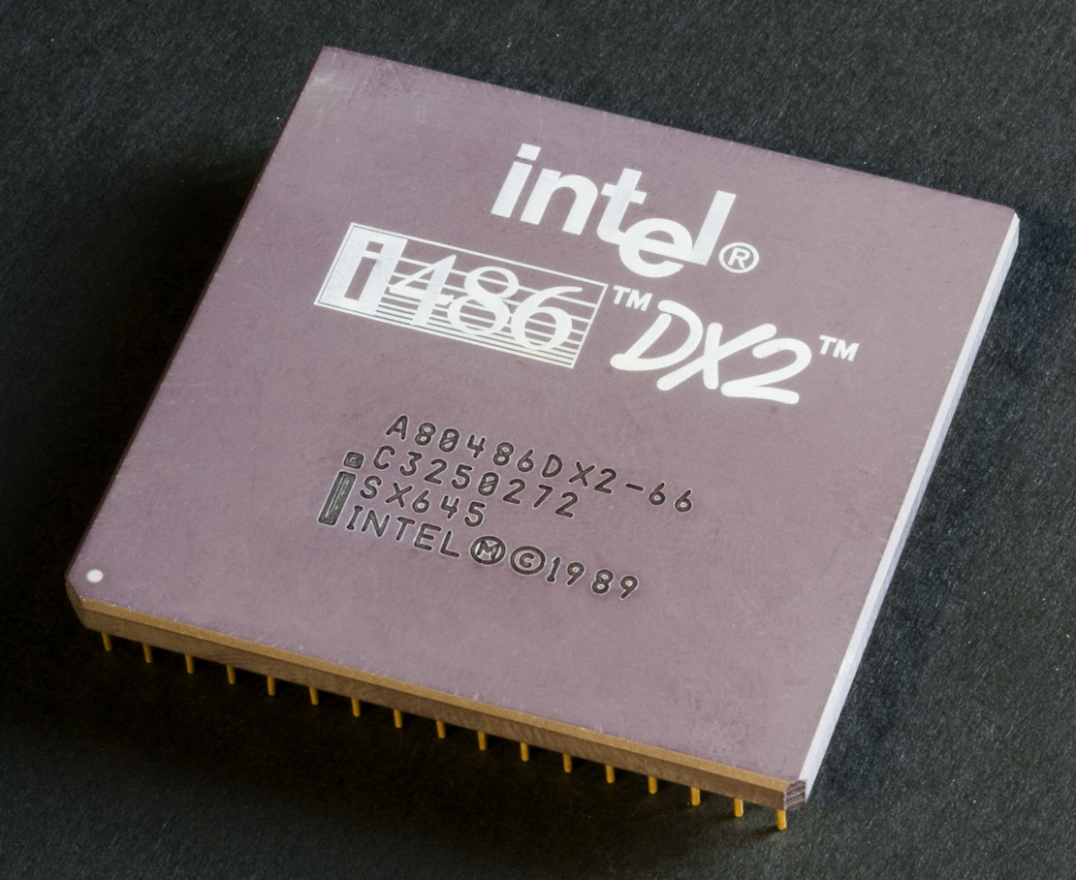
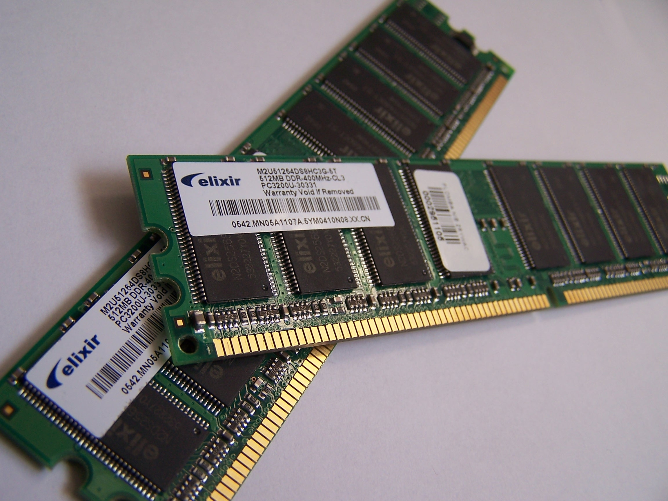
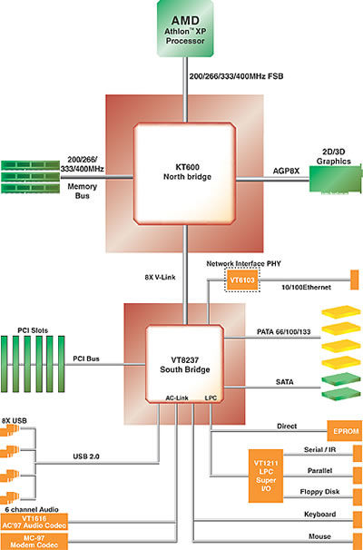
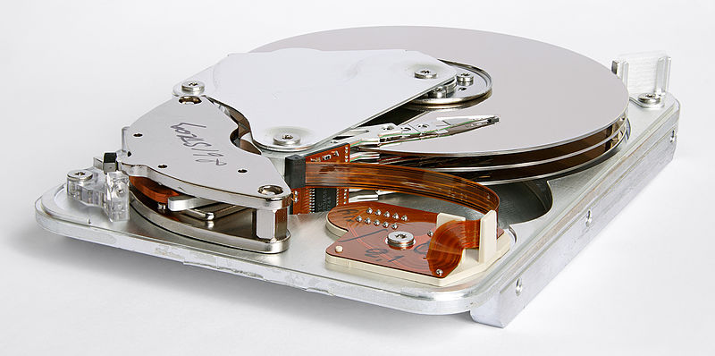
Handling memory
Notes:
Talk about graphics cards and problems that are not embarrassingly parallel, talk about Moore’s law and the revlopution of computing

Slide 18
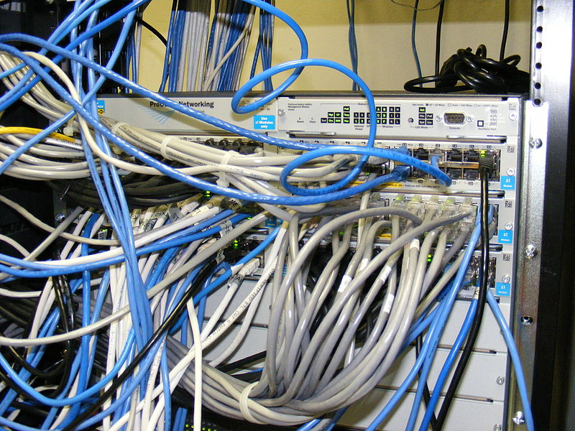
Handling memory
Notes:
Talk about graphics cards and problems that are not embarrassingly parallel, talk about Moore’s law and the revlopution of computing

Slide 19
Handling memory
Save your results in memory and then write to disk at the end
Notes:
Talk about graphics cards and problems that are not embarrassingly parallel, talk about Moore’s law and the revlopution of computing

Slide 20
Handling memory
Save your results in memory and then write to disk at the end
Output your code to a series of files
Simulation 1
Output1.rda
Seed
= 1
Simulation 2
Output2.rda
Seed
= 2
Simulation 3
Output3.rda
Seed
= 3
Notes:
Talk about graphics cards and problems that are not embarrassingly parallel, talk about Moore’s law and the revlopution of computing

Slide 21
Handling memory
Save your results in memory and then write to disk at the end
Output your code to a series of files
Write local code to read in your series of files automatically
Simulation 1
Output1.rda
Seed
= 1
Simulation 2
Output2.rda
Seed
= 2
Simulation 3
Output3.rda
Seed
= 3
Notes:
Talk about graphics cards and problems that are not embarrassingly parallel, talk about Moore’s law and the revlopution of computing

Slide 22
Handling memory
Save your results in memory and then write to disk at the end
Output your code to a series of files
Write local code to read in your series of files automatically
Simulation 1
Output1.rda
Seed
= 1
Simulation 2
Output2.rda
Seed
= 2
Simulation 3
Output3.rda
Seed
= 3
Notes:
Talk about graphics cards and problems that are not embarrassingly parallel, talk about Moore’s law and the revlopution of computing

Slide 23
Handling memory
Save your results in memory and then write to disk at the end
Output your code to a series of files
Write local code to read in your series of files automatically
Seed
X
1
2
3
4
50
50
21
21
Simulation 1
Output1.rda
Seed
= 1
X
= 50
Simulation 2
Output2.rda
Seed
= 2
X
= 50
Simulation 3
Output3.rda
Seed
= 3
X
= 21
Simulation 4
Output4.rda
Seed
= 4
X
= 21
Notes:
Talk about graphics cards and problems that are not embarrassingly parallel, talk about Moore’s law and the revlopution of computing

Slide 24
Handling memory
Save your results in memory and then write to disk at the end
Output your code to a series of files
Write local code to read in your series of files automatically
Build a timer into your code
Test your code locally to know your memory and time requirements
Notes:
Talk about graphics cards and problems that are not embarrassingly parallel, talk about Moore’s law and the revlopution of computing

Slide 25
Shell script on the cluster
i <- as.numeric(Sys.getenv("PBS_ARRAY_INDEX"))
do_simulation( i )
i <- as.numeric(Sys.getenv("PBS_ARRAY_INDEX"))
do_simulation( i )
i <- as.numeric(Sys.getenv("PBS_ARRAY_INDEX"))
do_simulation( i )
i <- as.numeric(Sys.getenv("PBS_ARRAY_INDEX"))
do_simulation( i )
i <- as.numeric(Sys.getenv("PBS_ARRAY_INDEX"))
do_simulation( i )
i <- as.numeric(Sys.getenv("PBS_ARRAY_INDEX"))
do_simulation( i )
i <- as.numeric(Sys.getenv("PBS_ARRAY_INDEX"))
do_simulation( i )
i <- as.numeric(Sys.getenv("PBS_ARRAY_INDEX"))
do_simulation( i )
i <- as.numeric(Sys.getenv("PBS_ARRAY_INDEX"))
do_simulation( i )
i <- as.numeric(Sys.getenv("PBS_ARRAY_INDEX"))
do_simulation( i )
do_simulation <- function( i )
{
# set random seed as i
# select your simulation parameters
# do your simulation
# save your output in a file named …i…
# include a timer
}

Slide 26
Imperial College high performance computing hpc.ic.ac.uk
The practice of running code on a cluster
cx1
A cluster of many ordinary computers
cx2
Massively parallel system
ax3
Large shared memory tasks

Slide 27
Imperial College high performance computing hpc.ic.ac.uk
The practice of running code on a cluster
cx1
A cluster of many ordinary computers
cx2
Massively parallel system
ax3
Large shared memory tasks

Slide 28

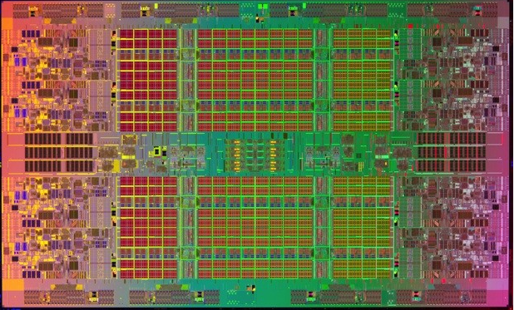
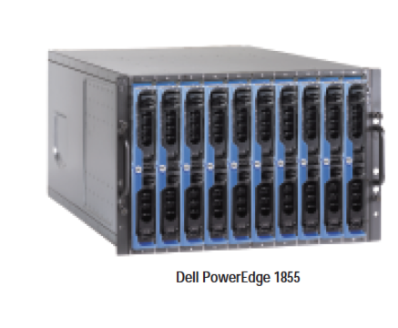
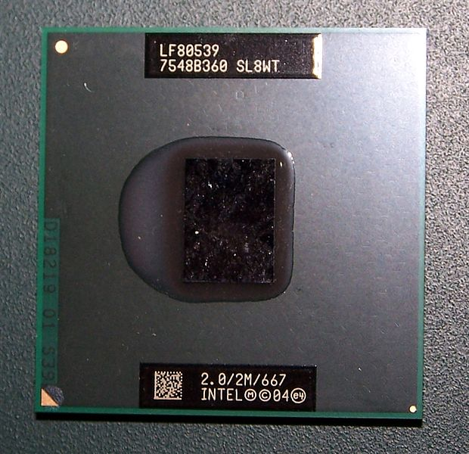
The Imperial College high performance computing PC cluster cx1.hpc.ic.ac.uk
Notes:
12192 cores on cx1 (2013 jan)
76*10*2*8

Slide 29
The Imperial College high performance computing PC cluster cx1.hpc.ic.ac.uk
Notes:
12192 cores on cx1 (2013 jan)
76*10*2*8

Slide 30
The Imperial College high performance computing PC cluster cx1.hpc.ic.ac.uk
Notes:
13558 cores on cx1 (2013 jan) 1395 nodes

Slide 31
The Imperial College high performance computing PC cluster cx1.hpc.ic.ac.uk

Slide 32

The Imperial College high performance computing PC cluster cx1.hpc.ic.ac.uk
Login node
your portal to cx1
Login.cx1.hpc.ic.ac.uk

Slide 33
The Imperial College high performance computing PC cluster cx1.hpc.ic.ac.uk
Login node
your portal to cx1
Login.cx1.hpc.ic.ac.uk
Queue

Slide 34
Where your data is stored…
$HOME
Backed up main area
10Gb
$WORK
For running jobs not backed up 150Gb
$TMPDIR
Ignore these temporary files, but be careful you don’t lose work in here!…

Slide 35
Where your data is stored…
You
Queue
$HOME
Backed up main area
10Gb
$WORK
For running jobs not backed up 150Gb
$TMPDIR
Ignore these temporary files, but be careful you don’t lose work in here!…

Slide 36
Where your data is stored…
You
Queue
This is your working directory
$HOME
Backed up main area
10Gb
$WORK
For running jobs not backed up 150Gb
$TMPDIR
Ignore these temporary files, but be careful you don’t lose work in here!…

Slide 37
Where your data is stored…
You
Queue
This is your working directory
$HOME
Backed up main area
10Gb
$WORK
For running jobs not backed up 150Gb
$TMPDIR
Ignore these temporary files, but be careful you don’t lose work in here!…
You
You!!
Notes:
Jobs running under the queuing system have their working directory set to $TMPDIR. This means that temporary and scratch files are on fast disk and are automatically deleted

Slide 38
Step 1: get your code onto the cluster
Go to filezilla-project.org
Download FileZilla Client and install it.
Open FileZilla and put in the following settings
Host: sftp://login.cx1.hpc.ic.ac.uk
Username: your username for all Imperial services
Password: your usual Imperial password
Port: 22
Press the Quickconnect button
Copy your files and folders across onto HPC.
Notes:
For the massively parallel system SGI Altix ICE (cx2):
ssh to login.cx2.hpc.ic.ac.uk
For the very large shared memory system SGI Altix UV (ax3):
ssh to ax3.hpc.ic.ac.uk

Slide 39
Step 1: get your code onto the cluster
Alternative method if you prefer command line…
Use sftp: from the directory of your code in a shell window type ….
sftp username@login.cx1.hpc.ic.ac.uk
You will be asked for your standard cluster password
put filename.R
exit
Your software is now on your home directory of the cluster which is backed up regularly
Notes:
For the massively parallel system SGI Altix ICE (cx2):
ssh to login.cx2.hpc.ic.ac.uk
For the very large shared memory system SGI Altix UV (ax3):
ssh to ax3.hpc.ic.ac.uk

Slide 40
Step 2: log into the cluster
Use ssh: from a shell window type ….
Ssh –l username login.cx1.hpc.ic.ac.uk
You will be asked for your standard cluster password
Now it’s as though you were sitting with a shell open at the login node.
ls (will list the files in $HOME)
mkdir foldername (make a new folder)
mv filename $HOME/foldername (move)
cd foldername (change directory)
cat filename (see your file to check it’s contents)
cp filename $WORK (make a copy in $WORK)
cd $WORK (change directory to $WORK)
Your software is now in two copies: in a folder in your home directory of the cluster and in the work area ready for running.
Notes:
For the massively parallel system SGI Altix ICE (cx2):
ssh to login.cx2.hpc.ic.ac.uk
For the very large shared memory system SGI Altix UV (ax3):
ssh to ax3.hpc.ic.ac.uk

Slide 41
Step 3: make a file for your shell script
This is the list of instructions to be executed when you get to the front of the queue is written in shell script. It should be a .sh file
Never run code on the login node – always write a shell script and wait in the queue.
If you type cat > filename.sh
You will then get the chance to type text (pressing enter for new lines) and the cat command will make the file containing the text that you typed.
When you are finished typing the contents of your new file press control and D to complete the process.
Type cat filename.sh to check that your file is correct before submitting it to the queue.
Notes:
For the massively parallel system SGI Altix ICE (cx2):
ssh to login.cx2.hpc.ic.ac.uk
For the very large shared memory system SGI Altix UV (ax3):
ssh to ax3.hpc.ic.ac.uk

Slide 42
Step 3 continued: your shell script file
#!/bin/bash
#PBS -l walltime=12:00:00
#PBS -l select=1:ncpus=1:mem=800mb
module load R
module load intel-suite
echo "R is about to run”
R --vanilla < $WORK/Rtest/ForwardsNTC_V5.R
mv datafilename* $WORK
echo "R has finished running”
# this is a comment at the end of the file
Notes:
Check that you have new line caracters in properly (don’t just copy and paste)

Slide 43
Step 3 continued: your shell script file
#!/bin/bash
#PBS -l walltime=12:00:00
#PBS -l select=1:ncpus=1:mem=800mb
module load R
module load intel-suite
echo "R is about to run”
R --vanilla < $WORK/Rtest/ForwardsNTC_V5.R
mv datafilename* $WORK
echo "R has finished running”
# this is a comment at the end of the file
You can run Python code too –
just use different commands here
Notes:
Check that you have new line caracters in properly (don’t just copy and paste)

Slide 44
Step 4: submitting your job to the cluster
You are now in the $WORK directory with your code and shell script both written.
To submit your job type
qsub -J 1-32 filename.sh
qstat (S changes from Q to B when running)
If you want to delete a job
qstat
qdel job-id[] (the [] is for array jobs only)
qstat will give you a list of jobs and you would get the job-id from there.
Notes:
For the massively parallel system SGI Altix ICE (cx2):
ssh to login.cx2.hpc.ic.ac.uk
For the very large shared memory system SGI Altix UV (ax3):
ssh to ax3.hpc.ic.ac.uk

Slide 45
Step 5: check that all is well
Wait 5-10 minutes then check that nothing has gone wrong.
qstat (is your job running still)
ls (are output files as expected)
cat filename.sh.ejob-id.index
(are error files empty?)
cat filename.sh.ojob-id.index
(are standard output files as expected)
qstat (is your job running still)
exit (you’re done for now come back later)
Notes:
For the massively parallel system SGI Altix ICE (cx2):
ssh to login.cx2.hpc.ic.ac.uk
For the very large shared memory system SGI Altix UV (ax3):
ssh to ax3.hpc.ic.ac.uk

Slide 46
Step 6: Getting your results back
qstat (is your job running still)
cd $WORK
ls (output files as expected?)
cat output filename (contents as expected?)
cat filename.sh.ejob-id.index
(error files empty?)
cat filename.sh.ojob-id.index
(standard output files as expected?)
tar czvf filename.tgz *
mv filename.tgz $HOME
Notes:
For the massively parallel system SGI Altix ICE (cx2):
ssh to login.cx2.hpc.ic.ac.uk
For the very large shared memory system SGI Altix UV (ax3):
ssh to ax3.hpc.ic.ac.uk

Slide 47
Step 6 continued: sftp to get results
exit
Use sftp: from a new directory on your own computer of where you want the results to be. Open a shell and type …
sftp username@login.cx1.hpc.ic.ac.uk
You will be asked for your standard cluster password
get filename.tgz
exit
Your results are now all on your own computer
tar xzvf filename.tgz
Your results are now complete uncompressed and ready for use. Now you need to write some R code to read in and analyze all those file.
Notes:
For the massively parallel system SGI Altix ICE (cx2):
ssh to login.cx2.hpc.ic.ac.uk
For the very large shared memory system SGI Altix UV (ax3):
ssh to ax3.hpc.ic.ac.uk

Slide 48
For your excercises
You’ll be asked to adapt your code from yesterday to run on the cluster for a much bigger ecological community size
You’ll need to collect species abundance data as before and average over a large number of parallel simulations.
Notes:
Talk about graphics cards and problems that are not embarrassingly parallel, talk about Moore’s law and the revlopution of computing

Slide 49
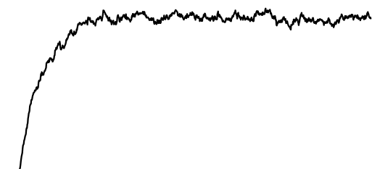
For your excercises
You’ll be asked to adapt your code from yesterday to run on the cluster for a much bigger ecological community size
You’ll need to collect species abundance data as before and average over a large number of parallel simulations.
v
v
Notes:
Talk about graphics cards and problems that are not embarrassingly parallel, talk about Moore’s law and the revlopution of computing

Slide 50
For your excercises
You’ll be asked to adapt your code from yesterday to run on the cluster for a much bigger ecological community size
You’ll need to collect species abundance data as before and average over a large number of parallel simulations.
v
v
Notes:
Talk about graphics cards and problems that are not embarrassingly parallel, talk about Moore’s law and the revlopution of computing

Slide 51
For your excercises
You’ll be asked to adapt your code from yesterday to run on the cluster for a much bigger ecological community size
You’ll need to collect species abundance data as before and average over a large number of parallel simulations.
Notes:
Talk about graphics cards and problems that are not embarrassingly parallel, talk about Moore’s law and the revlopution of computing

Slide 52
For your excercises
You’ll be asked to adapt your code from yesterday to run on the cluster for a much bigger ecological community size
You’ll need to collect species abundance data as before and average over a large number of parallel simulations.
Notes:
Talk about graphics cards and problems that are not embarrassingly parallel, talk about Moore’s law and the revlopution of computing

Slide 53
For your excercises
You’ll be asked to adapt your code from yesterday to run on the cluster for a much bigger ecological community size
You’ll need to collect species abundance data as before and average over a large number of parallel simulations.
Notes:
Talk about graphics cards and problems that are not embarrassingly parallel, talk about Moore’s law and the revlopution of computing

Slide 54
For your excercises
You’ll be asked to adapt your code from yesterday to run on the cluster for a much bigger ecological community size
You’ll need to collect species abundance data as before and average over a large number of parallel simulations.
Use a “burn in” period and check the species abundance distribution periodically.
Notes:
Talk about graphics cards and problems that are not embarrassingly parallel, talk about Moore’s law and the revlopution of computing

Slide 55
For your excercises
You’ll be asked to adapt your code from yesterday to run on the cluster for a much bigger ecological community size
You’ll need to collect species abundance data as before and average over a large number of parallel simulations.
Use a “burn in” period and check the species abundance distribution periodically. You should plot species richness against time and make a conservative judgment, but for neutral theory 8 * metacommunity size complete turnovers of the community is a good rule of thumb.
Notes:
Talk about graphics cards and problems that are not embarrassingly parallel, talk about Moore’s law and the revlopution of computing

Slide 56
Notes:
Take home messages

Slide 57
DO NOT …
Use the cluster without knowing memory and time requirements
Run jobs on the login node
Try to use cx2 or ax3 parts of the cluster
Output data to the hard disk regularly
Use the same random seed for your simulations
Copy and paste your shell script
Leave your results in $TMPDIR
Waste too much of your own time optimizing your code
Run code on the cluster that hasn’t been tested locally first
Notes:
Take home messages

Slide 58
DO …
Use the cluster for jobs that take a long time locally.
Optimize your code if there’s going to be a huge benefit
Run repeat readings and different parameters as separate jobs.
Run jobs that take between 30 mins and 3 days to execute.
Write your shell script on the cluster itself.
Make your code output each result in a differently named file.
Check periodically that all is well on the cluster
Be ambitious – you can do loads of great stuff with a cluster.
Notes:
Take home messages

